Slide 1
ALGORITHMS

Slide 2
Algorithms as a technology :
Efficiency.

Slide 3
Insertions sort
To sort an array of size n in ascending order:
1: Iterate from arr[1] to arr[n] over the array.
2: Compare the current element (key) to its predecessor.
3: If the key element is smaller than its predecessor, compare it to the elements before. Move the greater elements one position up to make space for the swapped element

Slide 4
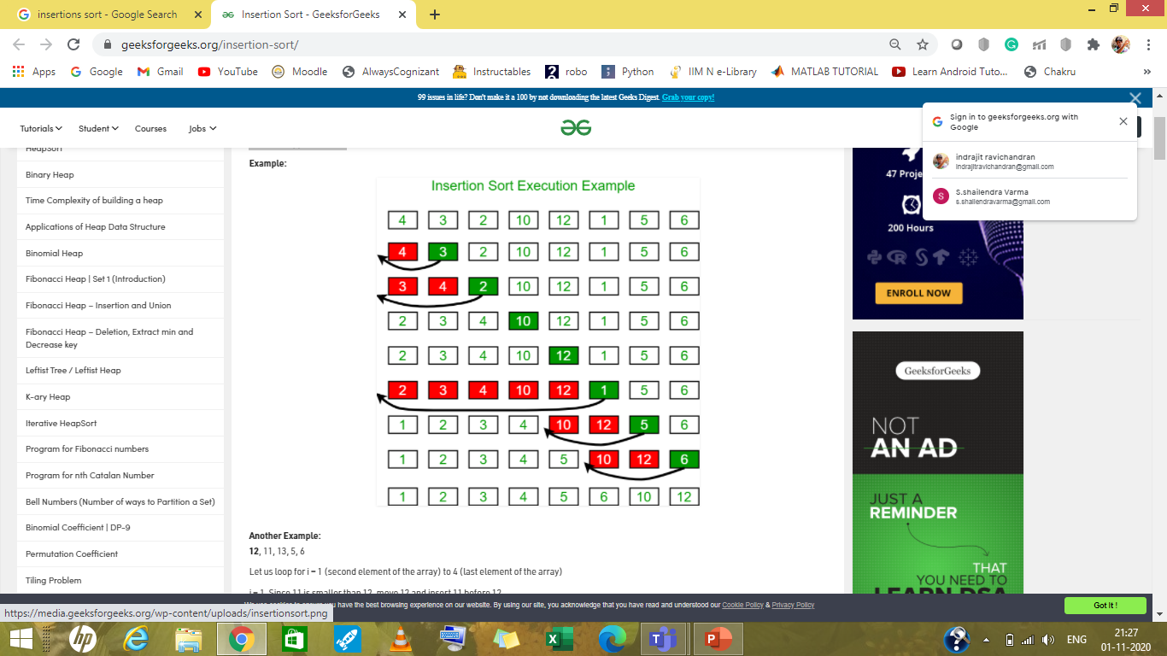

Slide 5
Insertion sort
void insertionSort(int arr[], int n)
{
int i, key, j;
for (i = 1; i < n; i++)
{
key = arr[i];
j = i - 1;
while (j >= 0 && arr[j] > key)
{
arr[j + 1] = arr[j];
j = j - 1;
}
arr[j + 1] = key;
}
}

Slide 6

Insertion sort complexity ?

Slide 7
ANALYSING algorithms
Algorithm analysis is an important part of computational complexity theory, which provides theoretical estimation for the required resources of an algorithm to solve a specific computational problem.
Most algorithms are designed to work with inputs of arbitrary length. Analysis of algorithms is the determination of the amount of time and space resources required to execute it.

Slide 8
Designing algorithms
The algorithms can be classified in various ways. They are:
Implementation Method
Recursion or Iteration
Exact or Approximate
Serial or Parallel or Distributed Algorithms
Design Method
Greedy Method, Divide and Conquer, Dynamic Programming, Linear Programming, Reduction
Other Classifications
Randomized Algorithms, Classification by complexity, Classification by Research Area, Branch and Bound Enumeration and Backtracking

Slide 9
Growth of functions

Slide 10
Is an O(N²) algorithm better than O(N) algorithm?
O(n) is asymptotically faster than O(n^2).
n is the size of data. So, an algorithm which takes O(n) time to solve a problem is faster than another algorithm which takes O(n^2) time to solve the same problem.

Slide 11
O(N²) → O(N)
Imagine you have two lists of numbers (from [0 to 1999] and [1000 to 2999]) and you want to find the intersection of these.( in python using lists or lists and dictionary )
finds number pairs (a, b) which satisfy the equation
a * b == sum(1, 2, 3 ..., n-2, n-1, n) - a - b (a , b between 1 to n)

